Slide 1
TEACHER’S PERSONAL INFORMATION
Name: Nguyen Thanh Loan
Facebook: Loan Nguyễn Thanh
Mobile number: 0942 255 937
Email: loannguyenthanh1978@gmail.com
Zalo lớp:
E 3A-DH20LC-010112284325

Slide 2

UNIT 7
DANGER

Slide 3
CONTENTS
Vocabulary: dangers, animals, fears and phobias.
Grammar: comparison, -ing forms and phobias.
Function: giving yourself time to think.

Slide 4
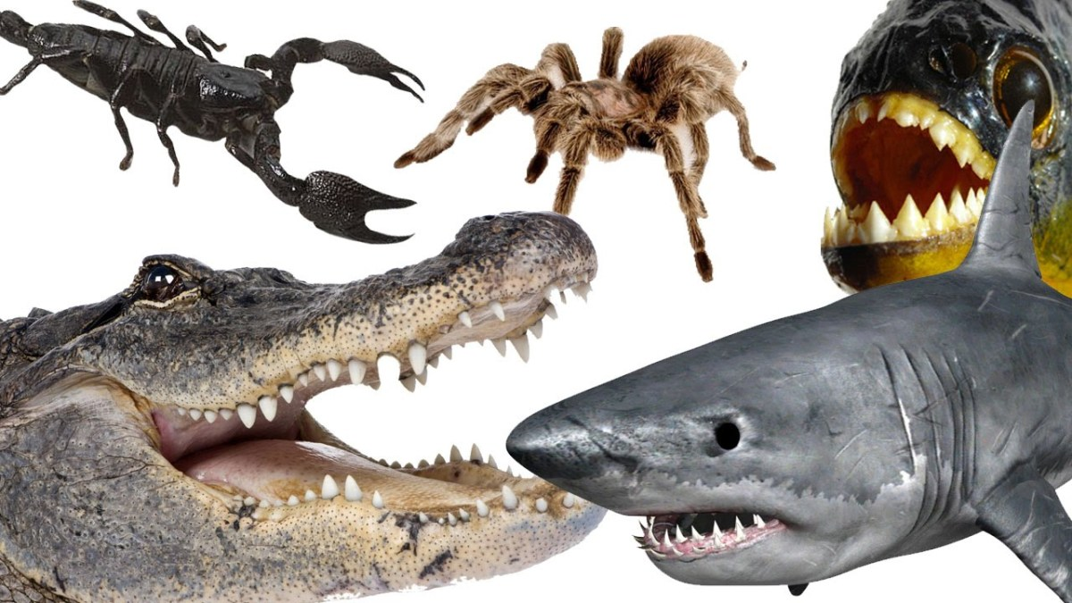
LESSON 1
WHAT’S MORE DANGEROUS?

Slide 5
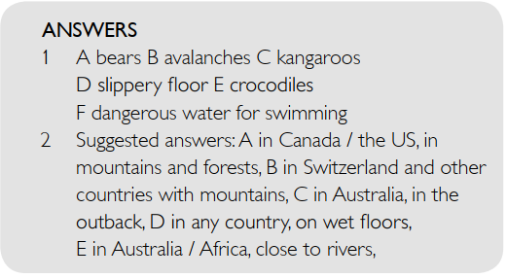
SPEAKING
Work in groups and talk about the signs in the photos.
1. What danger is each sign warning us about?
What could happen?
2. Where can you find these signs?

Slide 6
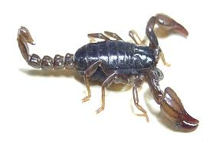
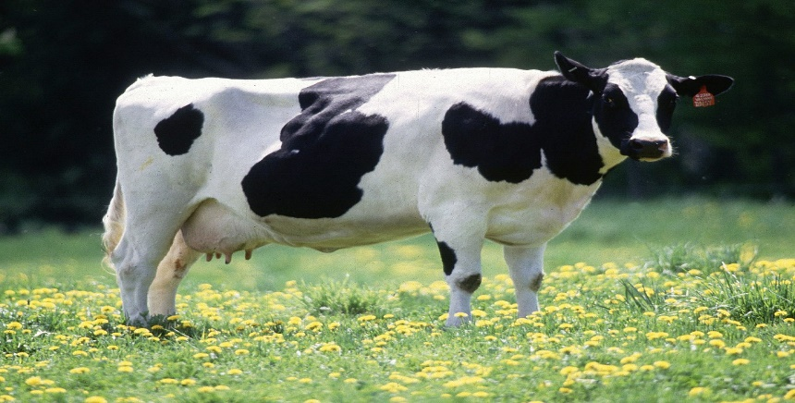
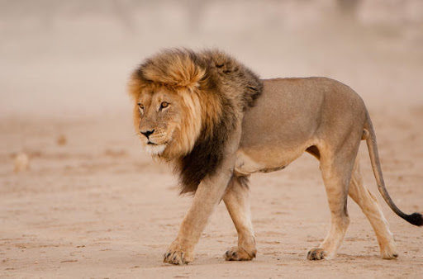
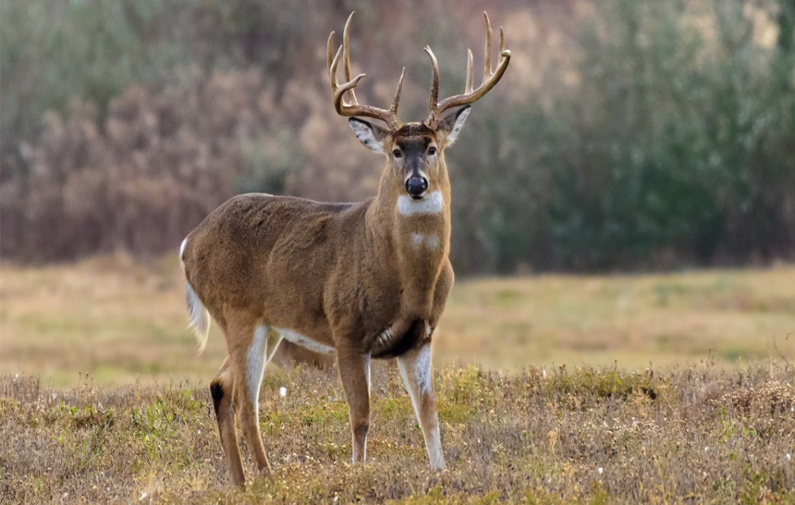
Vocabulary
Animals
scorpion
/ˈskɔː.pi.ən/
cow
/kaʊ/
lion
/ˈlaɪ.ən/
deer
/dɪər/

Slide 7
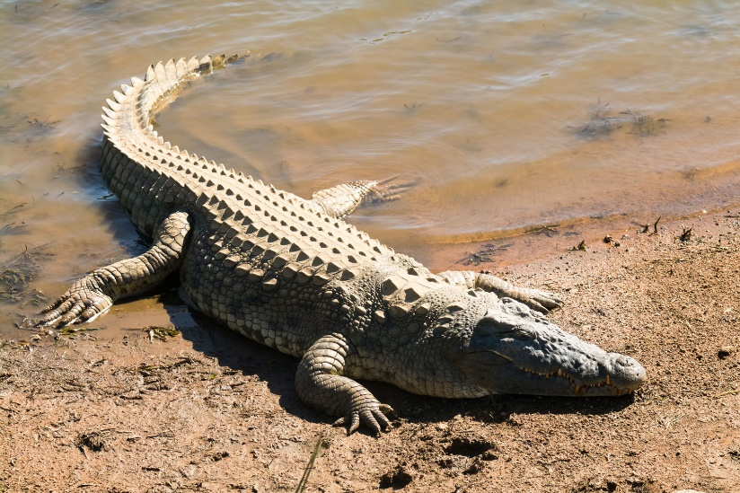
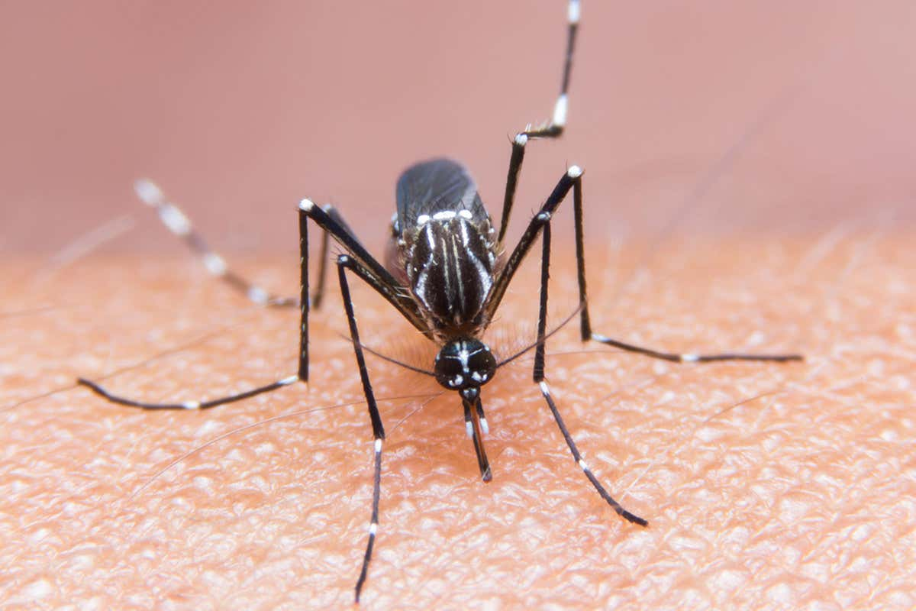
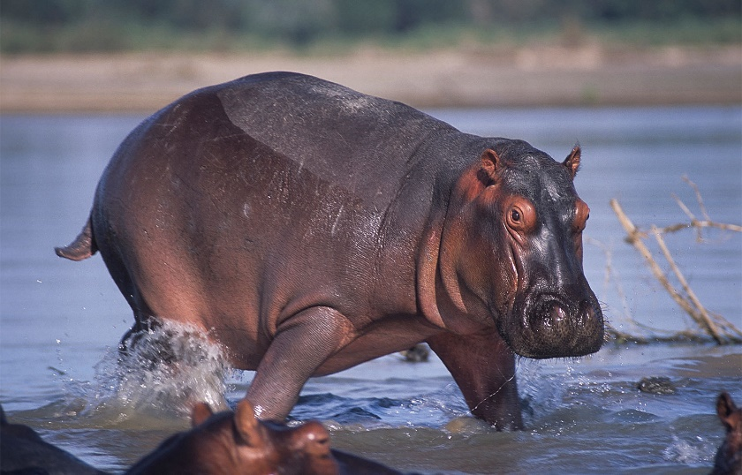
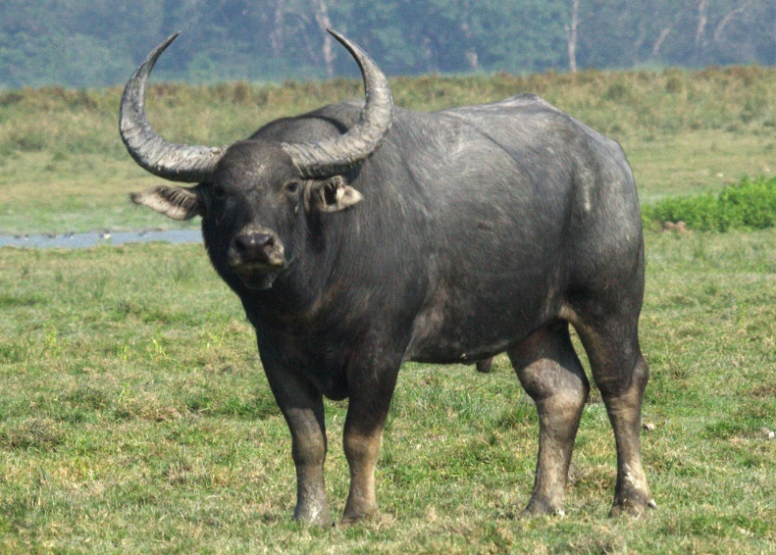
Vocabulary
Animals
crocodile
/ˈkrɒk.ə.daɪl/
mosquito
/məˈskiː.təʊ/
hippo
/ˌhɪp.əˈpɒt.ə.məs/
buffalo
/ˈbʌf.ə.ləʊ/

Slide 8
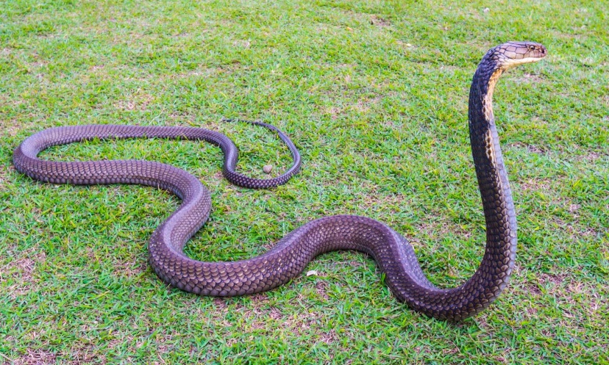
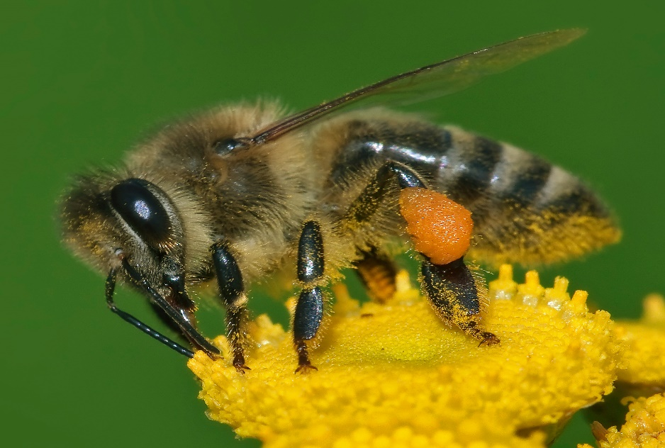
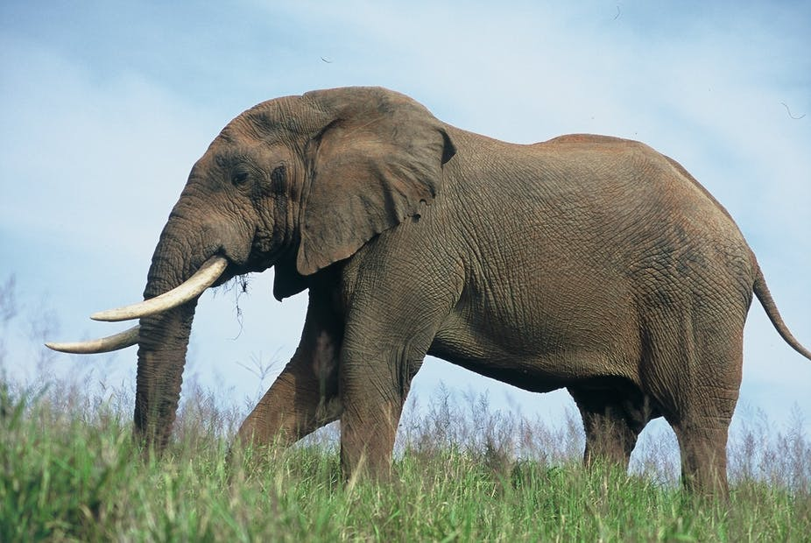
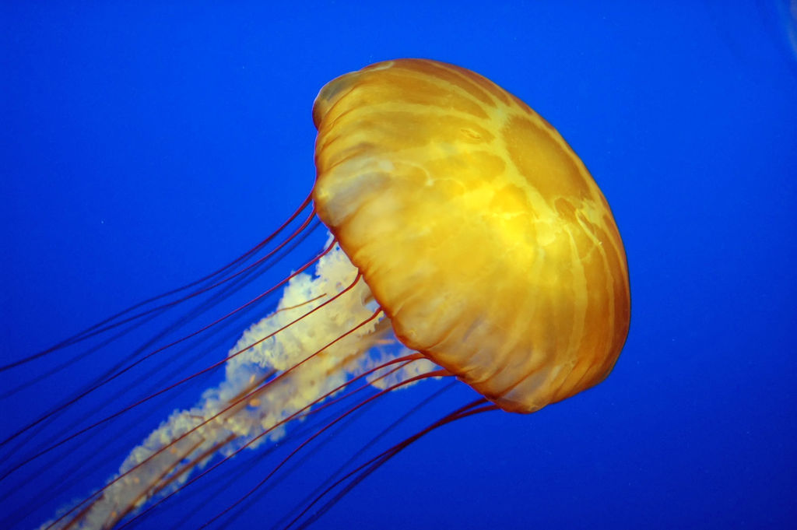
Vocabulary
Animals
snake
/sneɪk/
bee
/biː/
elephant
/ˈel.ɪ.fənt/
jellyfish
/ˈdʒel.i.fɪʃ/

Slide 9
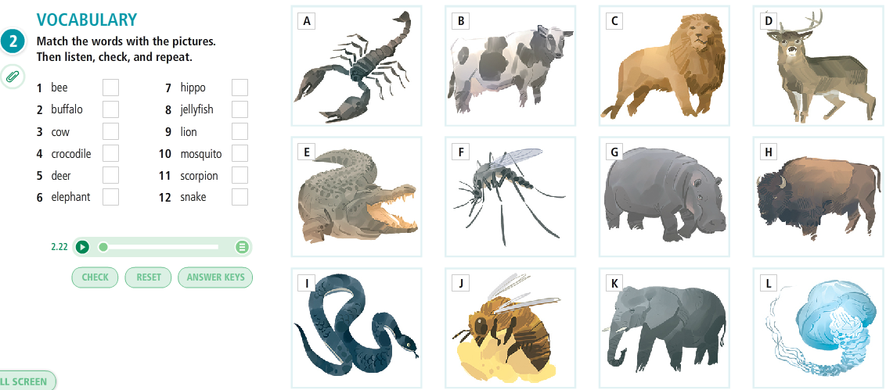
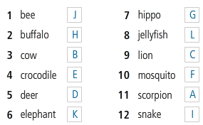
Vocabulary
Animals

Slide 10
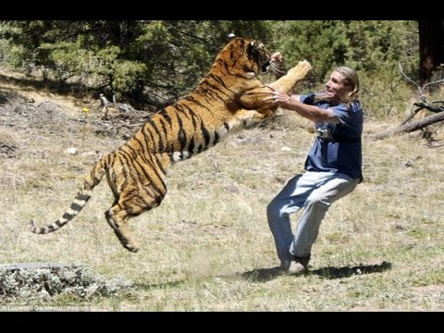
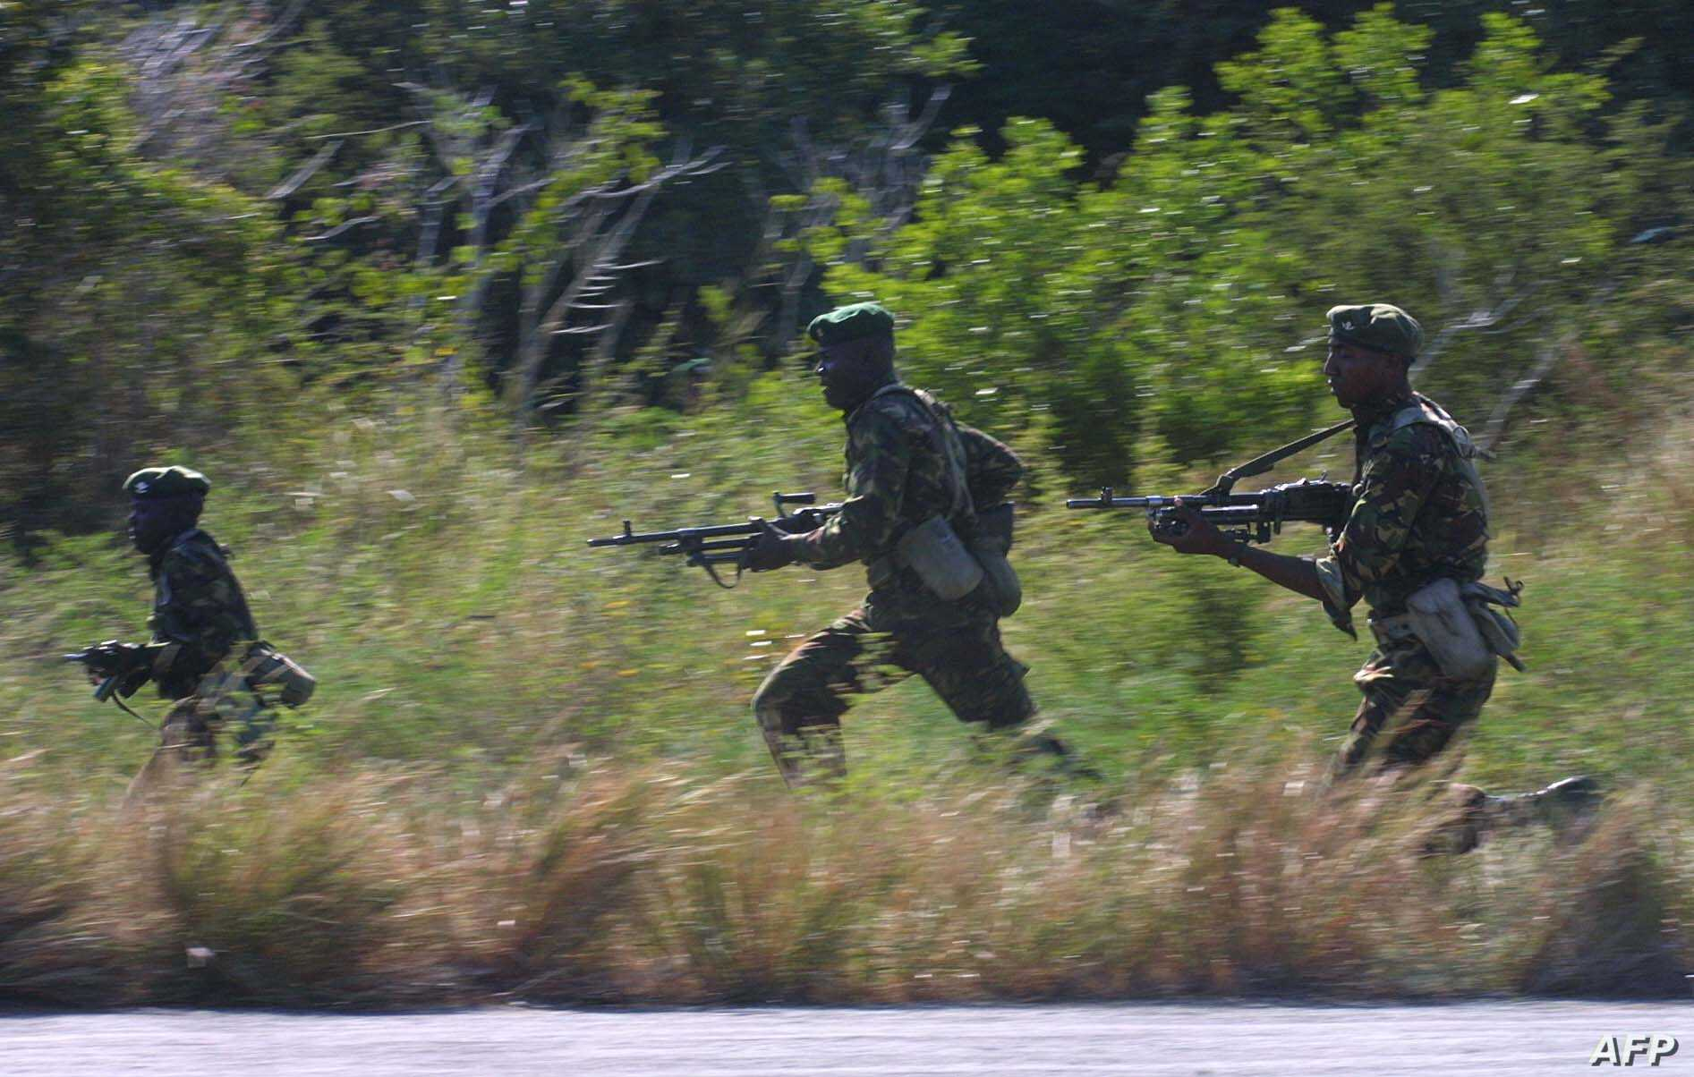
Vocabulary
Animals
attack
/əˈtæk/
Army forces have been attacking the town since dawn
to try to hurt or defeat using violence

Slide 11
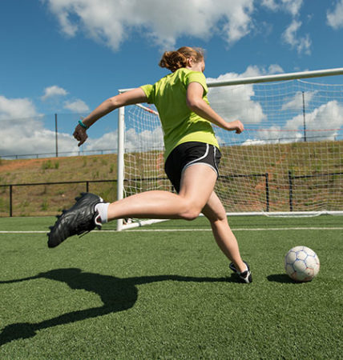
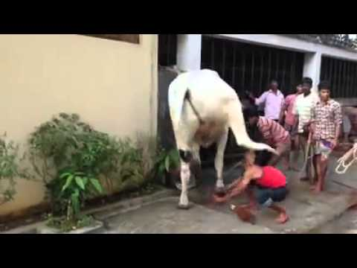
Vocabulary
Animals
kick
to hit someone or something with the foot, or to move the feet and legs suddenly and violently
I kicked the ball as hard as I could.

Slide 12
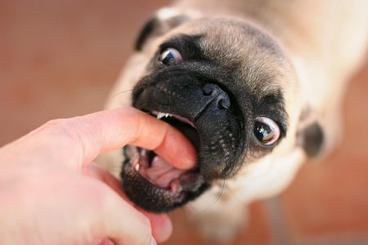
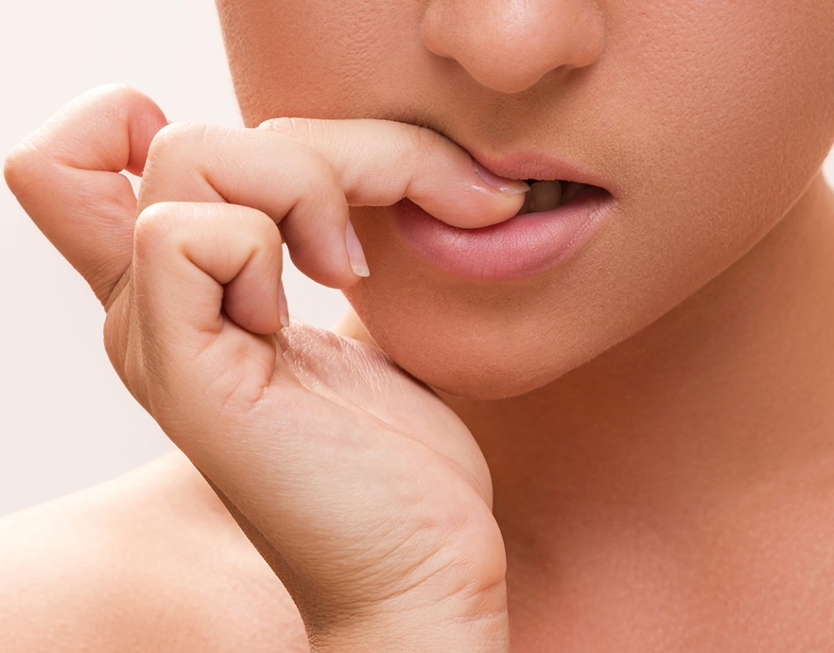
Vocabulary
Animals
bite
/baɪt/
She bites her fingernails.
to use your teeth to cut into something or someone

Slide 13
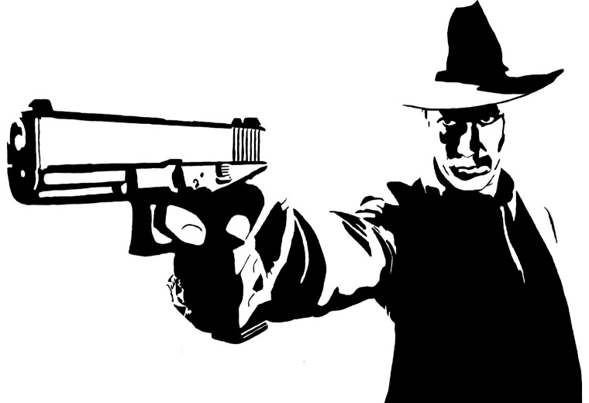
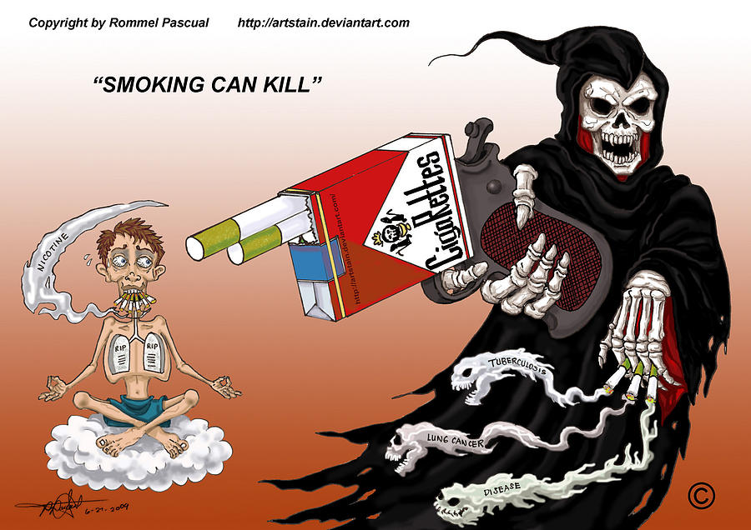
Vocabulary
Animals
kill
Smoking can kill
to cause someone or something to die

Slide 14
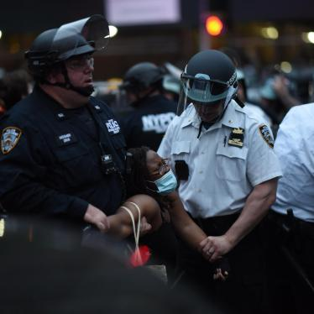
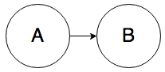
Vocabulary
Animals
cause
/kɔːz/
the reason why something, especially something bad, happens
The police are still trying to establish the cause of the fire.

Slide 15
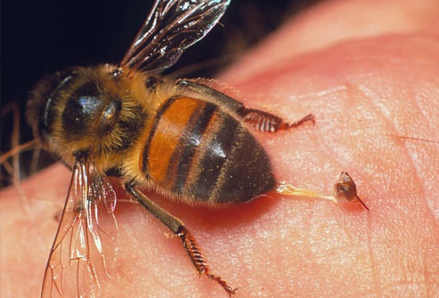
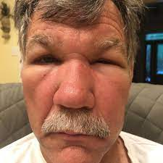
Vocabulary
Animals
sting
If an insect, plant, or animal stings, it produces a small but painful injury, usually with a poison, by brushing against the skin or making a very small hole in the skin
I got stung by a wasp yesterday.

Slide 16
Vocabulary
Animals
scorpion
cow
/kaʊ/
/ˈskɔː.pi.ən/
Kill, sting
kick
lion
/ˈlaɪ.ən/
deer
attack, kill
/dɪər/
kick

Slide 17
Vocabulary
Animals
crocodile
mosquito
/məˈskiː.təʊ/
/ˈkrɒk.ə.daɪl/
Kill, bite
Bite, cause (malaria)
hippo
buffalo
/ˈbʌf.ə.ləʊ/
/ˌhɪp.əˈpɒt.ə.məs/
Kill
Kick

Slide 18

Vocabulary
Animals
snake
/sneɪk/
bee
/biː/
bite
sting
elephant
/ˈel.ɪ.fənt/
jellyfish
/ˈdʒel.i.fɪʃ/
attack
sting

Slide 19
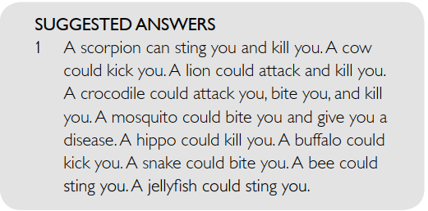
Vocabulary
Animals
Talk about the animals using the verbs given.
attack bite cause disease
kick kill sting

Slide 20
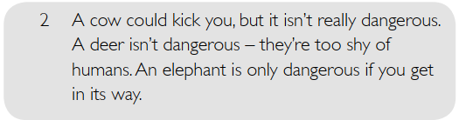
DISCUSS THE QUESTIONS
1. Which of these animals are dangerous? Why? What could they do to you?
2. Which animals aren’t dangerous? Why not?
3. Which animal do you think is the most / least dangerous?
4. Which of these animals do you think have you seen in real life?
5. Do you like or dislike any of them?

Slide 21

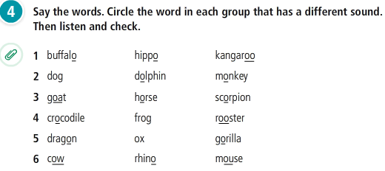
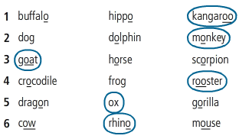
Listening
Animals

Slide 22
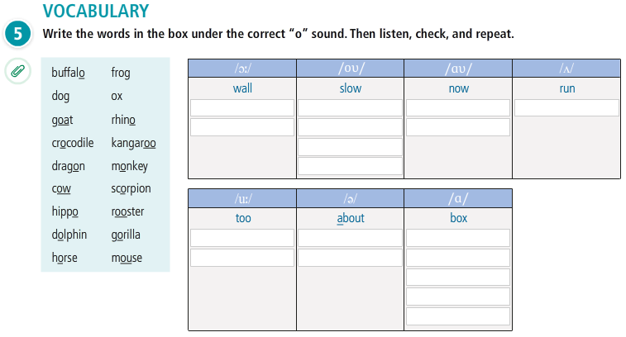
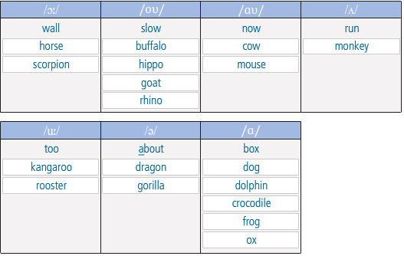

Slide 23
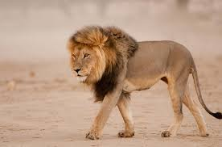
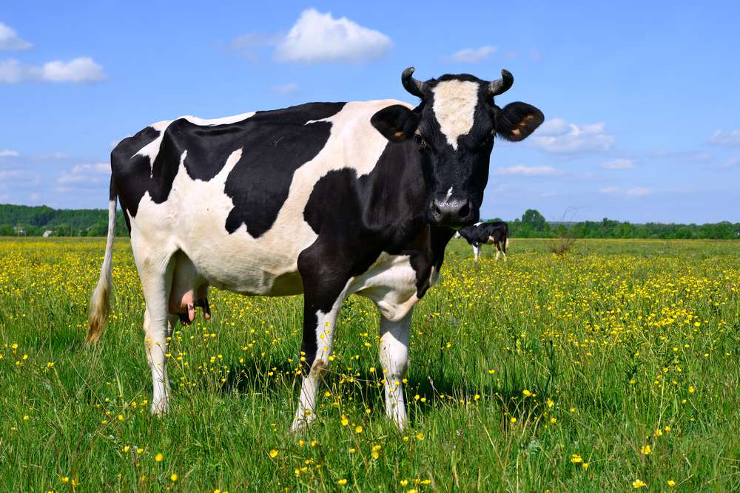
Grammar
Comparison
A little (more) / a lot (less)
small
Lions / a little / small / cows
Lions are a little smaller than cows

Slide 24

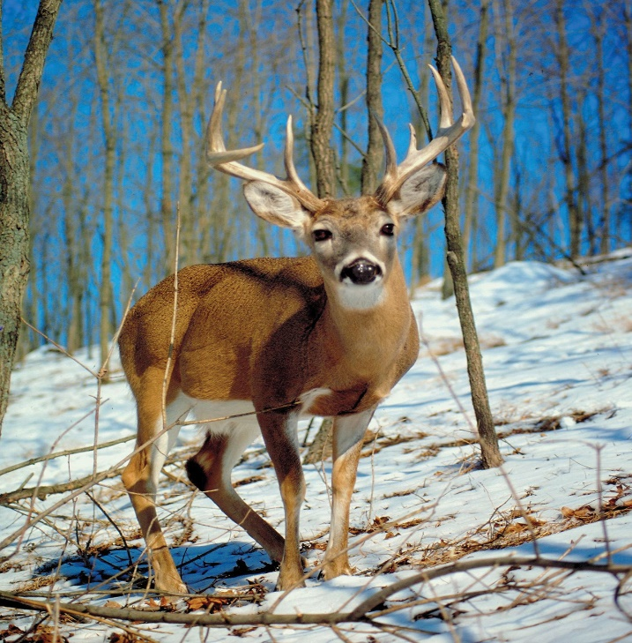
Grammar
Comparison
A little (more) / a lot (less)
big
Hippos / a lot / bigger / deer
Hippos are a lot bigger than deer

Slide 25
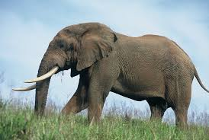
Grammar
Comparison
A little (more) / a lot (less)
intelligent
Elephants / a little / intelligent / jellyfish
Elephants are a little more intelligent than jellyfish
= Jellyfish are a little less intelligent than elephants.

Slide 26
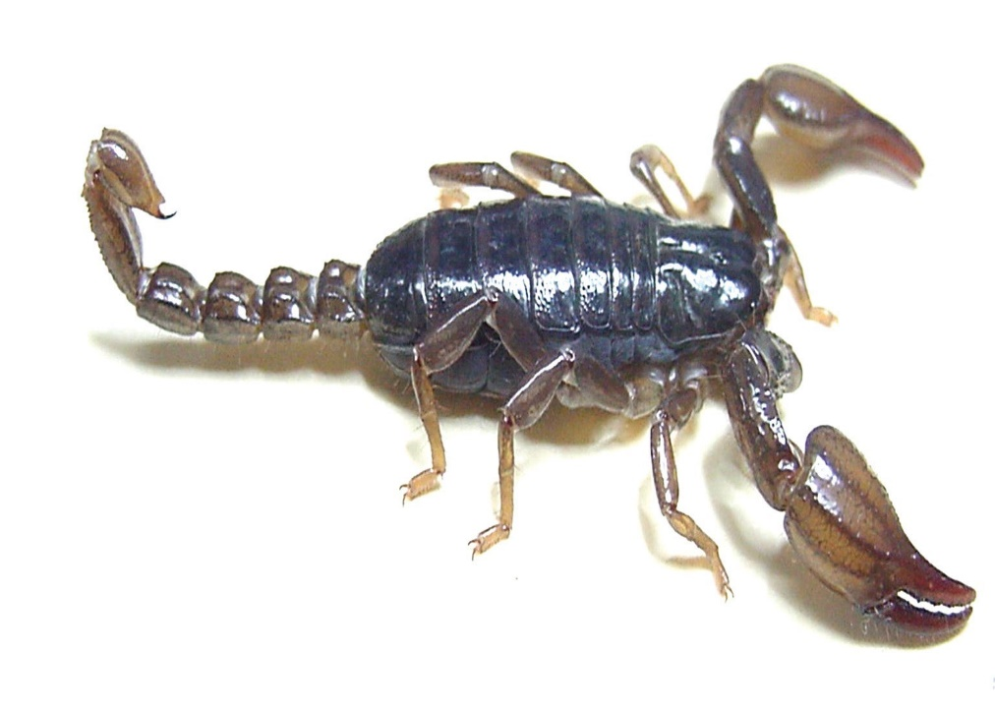
Grammar
Comparison
A little (more) / a lot (less)
dangerous
Scorpions / a lot / dangerous / mosquitoes
Scorpions are a lot less dangerous than mosquitoes

Slide 27
Unit 7: DANGER
Lesson 1: What’s more dangerous?
GRAMMAR
Comparison: a little (more) / a lot (less)
We use much, a lot, far, a bit, a little, slightly before an adjective or adverb to emphasise the degree of comparison.
Quantifiers | Size of differences
much/far/a lot (Much is more formal than a lot.) Ex: Lemon is much sourer than a lime. | Large differences
slightly/a little/a bit (A little is more formal than a bit.) Ex: Orange is slightly juicier than a watermelon. | Small differences

Slide 28
Unit 7: DANGER
Lesson 1: What’s more dangerous?
GRAMMAR
Comparison: a little (more) / a lot (less)
Underline the comparative form of the adjective or adverbs in each sentence below.
1. His car is far better than yours.
2. Jim’s watch is slightly more expensive than mine.
3. A watermelon is much sweeter than a lemon.
4. Alice’s bag is slightly heavier than Angele’s one.
5. She began to speak a bit more quickly.
6. Alison studies a lot harder than her sister.
7. Sam drives a little (bit) more carefully than Tom.
8. I work a lot more effectively when I have a good night's sleep. 9. Does your new stereo play music much more loudly than your old one did?

Slide 29
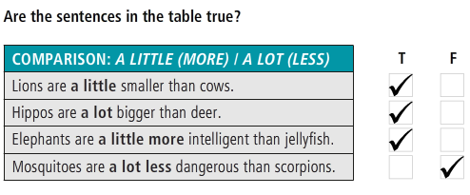
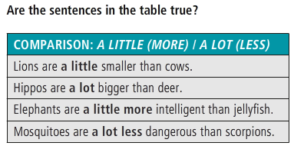
Grammar
Comparison
A little (more) / a lot (less)

Slide 30
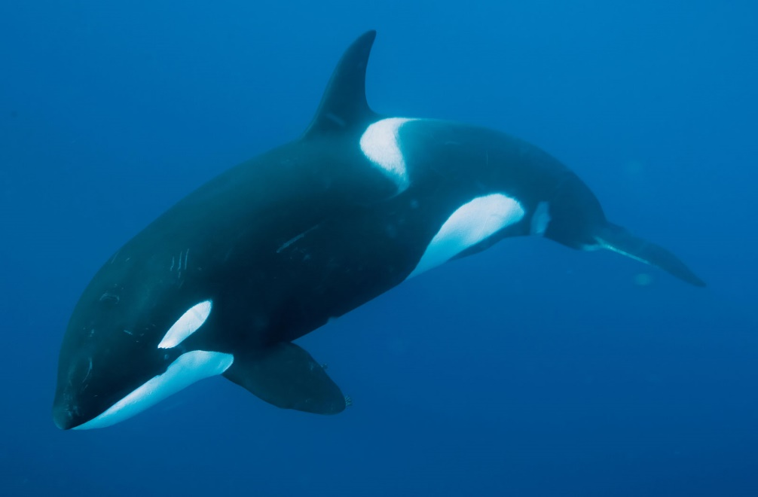
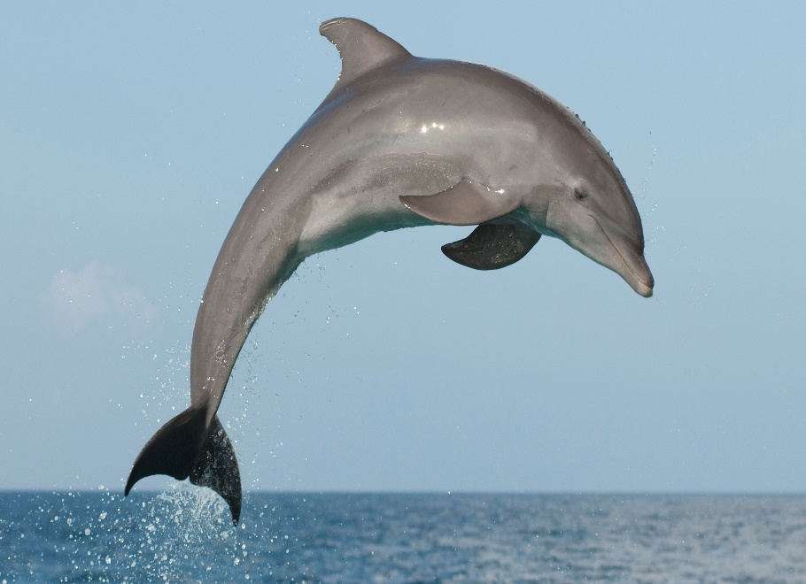
Grammar practice
Comparison
A little (more) / a lot (less)
heavy
whales …………… dolphins

Slide 31

Grammar
Comparison
A little (more) / a lot (less)
intelligent
Elephants …………………hippos.

Slide 32
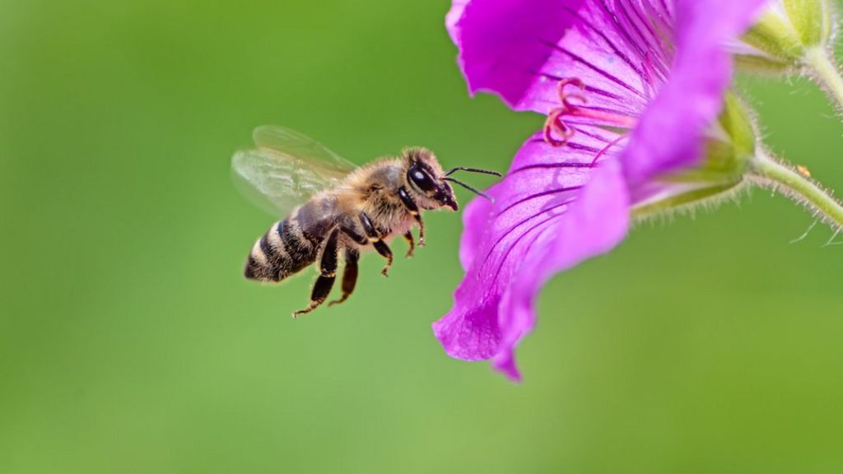
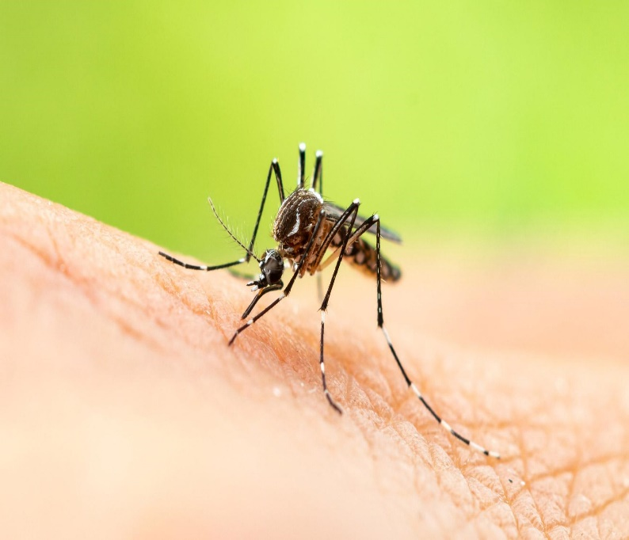
Grammar practice
Comparison
A little (more) / a lot (less)
dangerous
Bees ……………….. mosquitoes

Slide 33
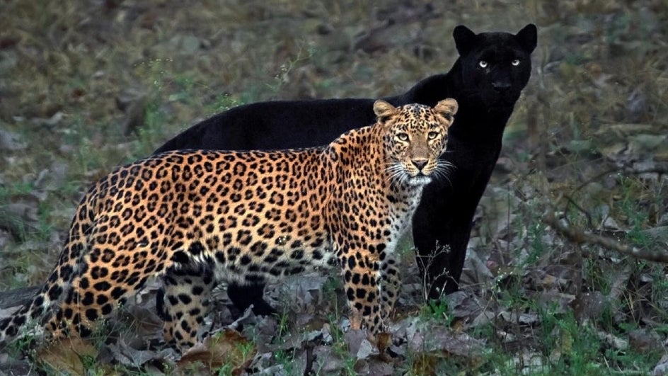

Grammar practice
Comparison
A little (more) / a lot (less)
graceful
Panthers …………………… deer

Slide 34
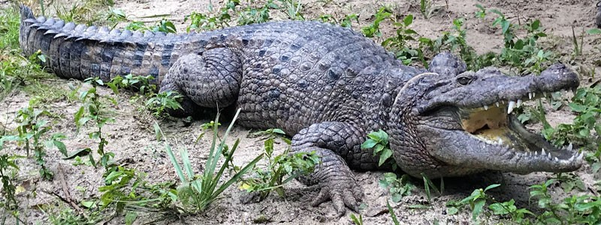
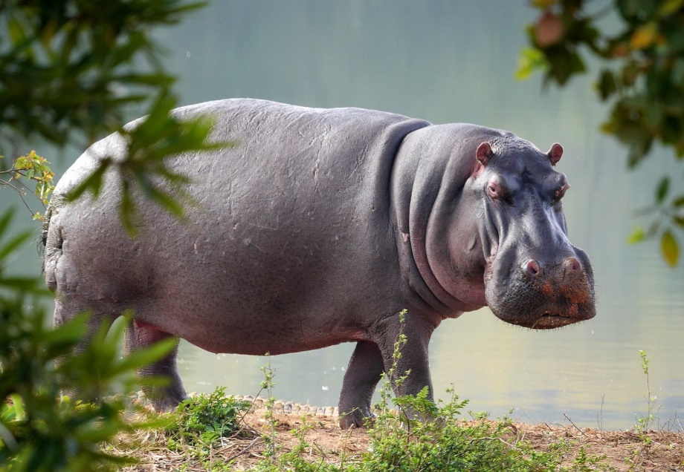
Grammar practice
Comparison
A little (more) / a lot (less)
ugly
Crocodiles………………… hippos.

Slide 35
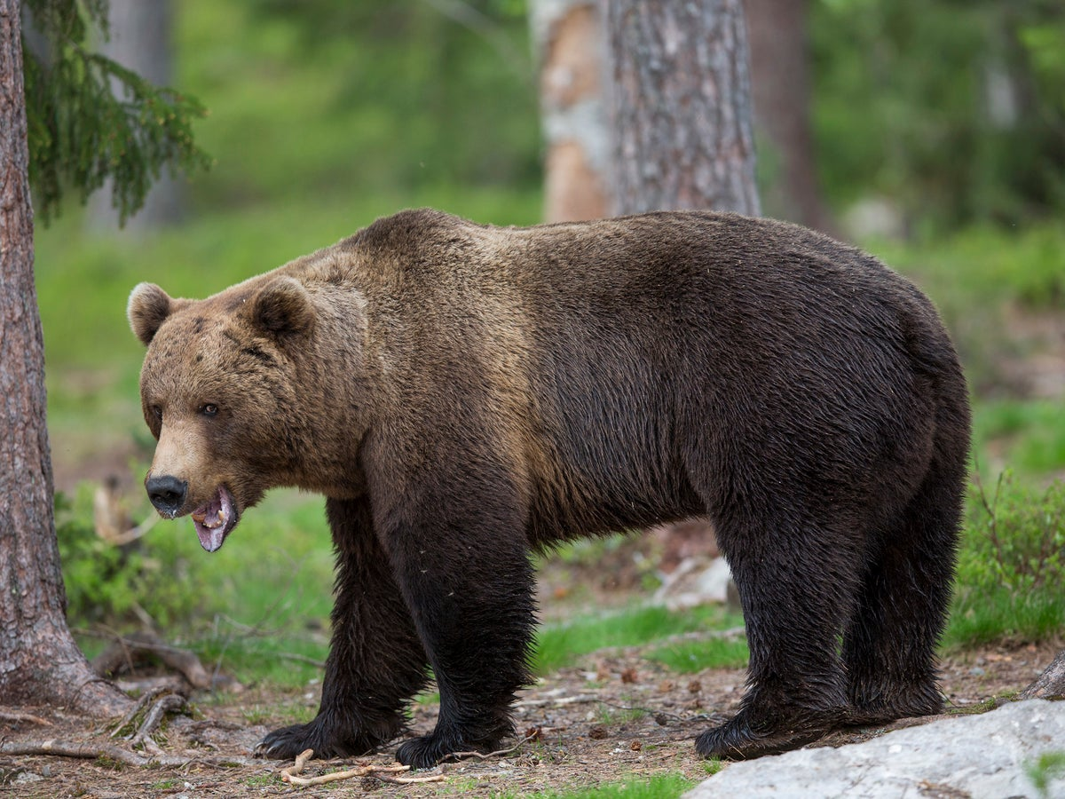
Grammar practice
Comparison
A little (more) / a lot (less)
slow
Brown bears ………………. lions.

Slide 36
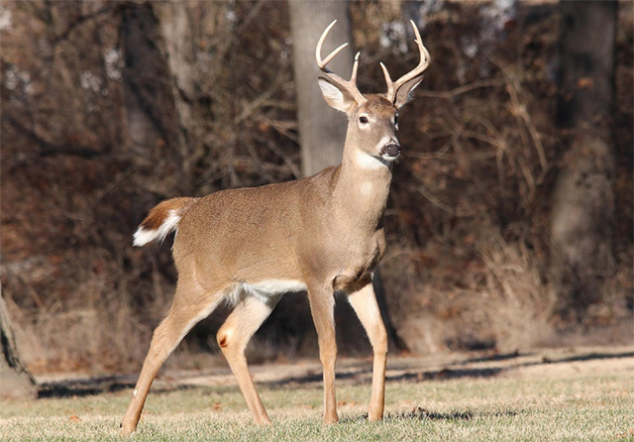

Grammar practice
Comparison
A little (more) / a lot (less)
fast
Deer ………………….. horses

Slide 37

Grammar practice
Comparison
A little (more) / a lot (less)
big
Mosquitoes …………………. mice

Slide 38


Listening

Slide 39
Unit 7: DANGER
Lesson 1: What’s more dangerous?
GRAMMAR
Comparison: a little (more) / a lot (less)
Complete the sentences with a little or a lot + more, or less + adjective.
1. Mosquitoes are a lot more dangerous than crocodiles. 2. Crocodiles are ______________________ mosquitoes. 3. Hippos are _____________________ scorpions. 4. Scorpions _______________________ snakes. 5. Snakes are _____________________ crocodiles.

Slide 40

1.5 (P. 5)

Slide 41




Presentation
Describe an animal by comparing it to other animals, using comparison with a little (more) / a lot (less).
dangerous
kill
malaria

Slide 42

Homework
Describe an animal by comparing it to other animals, using comparison with a little (more) / a lot (less).

Slide 43
Reference
Grammar
https://www.youtube.com/watch?v=vj3SbCwQd9I&t=244s
https://www.youtube.com/watch?v=E71eT-xDch8
Game
https://www.youtube.com/watch?v=U0MMiNG792M
https://www.youtube.com/watch?v=9_RolSXr2lU
Listening and reading
https://www.youtube.com/watch?v=Cr8eVw0XjAQ

Slide 44
The end!

